Slide 2
Build a holistic migration plan with Microsoft Azure
Abdul Rasheed Feroz Khan
Founder – CodeSizzler India | UAE
feroz@codesizzler.info

Slide 3

Abdul Rasheed Feroz Khan
Founder – CodeSizzler India | UAE
Microsoft MVP – Azure
Azure Cloud Advocate
Microsoft Partners

Slide 4





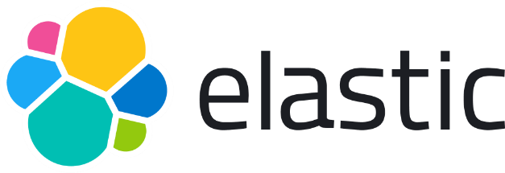
Platinum Partner
Gold Partner
Silver Partner

Slide 5
Agenda
Choose a compute service
Design for Azure virtual machine solutions
Design for Azure App Services solutions
Design for Azure Container Instances solutions
Design for Azure Kubernetes Service solutions
Design for Azure Function solutions
Design for Azure Logic App solutions

Slide 6
Why Microsoft Azure??

Slide 7
Compute Solution on Microsoft Azure

Slide 8
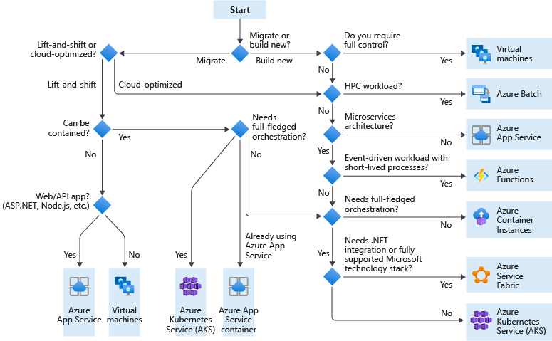

Slide 9
Azure Virtual Machine Solutions

Slide 10
When to select virtual machines
Know when to use virtual machines
Quickly test and troubleshoot different configurations
Use specialty hardware such as high-performance computing
Extend your on-premises datacenter without purchasing additional hardware
Run legacy apps on modern hardware
Access third party software that requires local add-ons or plug-ins
Quickly migrate apps to the cloud
Fully control the computing environment

Slide 11
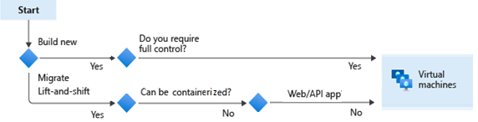
Plan the Azure virtual machine deployment
Azure virtual machines scenarios include build new or migrate patterns
Start with the network
Name the VM
Decide the VM location
Select the VM storage
Select an VM operating system
Keep the VM up to date
Monitor the VM
Notes:
This is just to highlight how large the responsibilities are when using VMs versus other more cloud native solutions
Windows virtual machines in Azure - https://docs.microsoft.com/azure/virtual-machines/windows/overview
Windows virtual machines in Azure - https://docs.microsoft.com/azure/virtual-machines/linux/overview

Slide 12


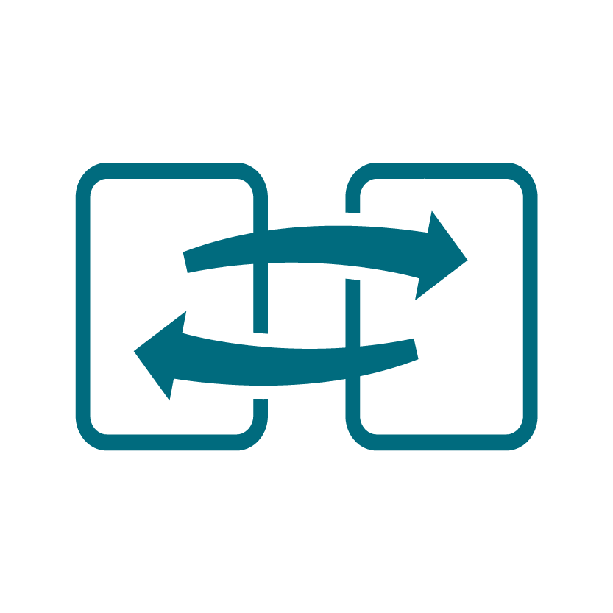
Determine the virtual machine family
The virtual machine size determines pricing
General purpose
Storage optimized
Compute optimized
GPU
Memory optimized
High performance compute
Notes:
Sizes for virtual machines in Azure - https://docs.microsoft.com/azure/virtual-machines/sizes
There is a VM selector tool - https://aka.ms/vm-selector
General purpose - Balanced CPU-to-memory ratio. Ideal for testing and development, small to medium databases, and low to medium traffic web servers.
Compute optimized - Compute optimized designed for high CPU-to-memory ratio. Suitable for medium traffic web servers, network appliances, batch processes, and application servers.
Memory optimized - Designed for high memory-to-CPU ratio. Great for relational database servers, medium to large caches, and in-memory analytics.
Storage optimized - Designed to have high disk throughput and IO. Ideal for VMs running databases.
GPU - Specialized for heavy graphics rendering and video editing. Ideal for model training and inferencing with deep learning.
High performance compute - The fastest and most powerful CPU virtual machines with optional high-throughput network interfaces.

Slide 13
When to select virtual machine scale sets
Scale sets are built from virtual machines. With scale sets, the management and automation layers are provided to run and scale your applications.
Scenario | Group of virtual machines | Virtual machine scale sets*
You need to add VM instances for changing workload | Manual process to create, configure, and ensure compliance | Automatically create from central configuration
You need to balance and distribute workloads | Manual process to create and configure Azure load balancer or Application Gateway | Can automatically create and integrate with Azure load balancer or Application Gateway
You need high availability and redundancy | Manually create Availability Set or distribute and track VMs across Availability Zones | Automatic distribution of VM instances across Availability Zone (when zones are selected) and Availability Set
You need to monitor and then scale virtual machines | Manual monitoring and Azure Automation | Autoscale based on host metrics, in-guest metrics, Application Insights, or schedule
* Ensure application supports VMSS
Notes:
The following table outlines the benefits of scale sets compared to manually managing multiple VM instances.
Add note about application compatibility with VMSS

Slide 14
Azure App Service Solutions

Slide 15
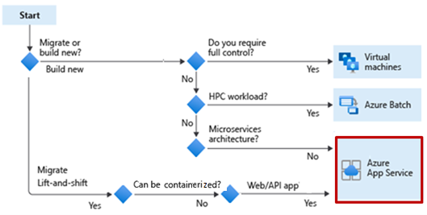
When to use Azure App Services Web Apps
Azure App Service is an HTTP-based service that lets you build and host apps
Web apps, background jobs, mobile backends, and RESTful APIs.
Use the programming language of your choice
Automatic scaling and high availability
App Service enables automated deployments from GitHub, Azure DevOps, or other source control services
Notes:
Important: Azure App Service is platform as a service (PaaS) environment. You focus on the website development and API logic. Azure handles the infrastructure to run and scale your web applications.

Slide 16


Considerations for App Service Web Apps
Determine the appropriate app service plan – determines cost and scaling
Use built-in authentication and authorization capabilities
Use App Services deployment slots for continuous deployment
Build REST-based web apps with the API
Use WebJobs to run a program or script
Use the Mobile Apps to build a back end for iOS and Android apps.

Slide 17
Compare containers to virtual machines
App Services can also run containers
Feature | Containers | Virtual Machines
Isolation | Lightweight isolation from the host and other container. | Complete isolation, strong security boundary, from the host and other VMs.
Operating system | Runs the user mode portion of an operating system | Runs a complete operating system
Deployment | Deploy using Docker | Deploy in the cloud or on-premises – portal, PowerShell, CLI, templates, automation ..
Persistent storage | Azure disks or file share | Virtual hard disk (VHD)or a file share
Fault tolerance | If a cluster node fails, any containers running on it are rapidly recreated by the orchestrator on another cluster node. | VMs can fail over to another server in a cluster, with the VM’s operating system restarting on the new server.
Notes:
Containers vs. virtual machines - https://docs.microsoft.com/virtualization/windowscontainers/about/containers-vs-vm
Navigate back to decision tree to show how the student would end up choosing App Services with containers

Slide 18
Azure Container Instances Design

Slide 19
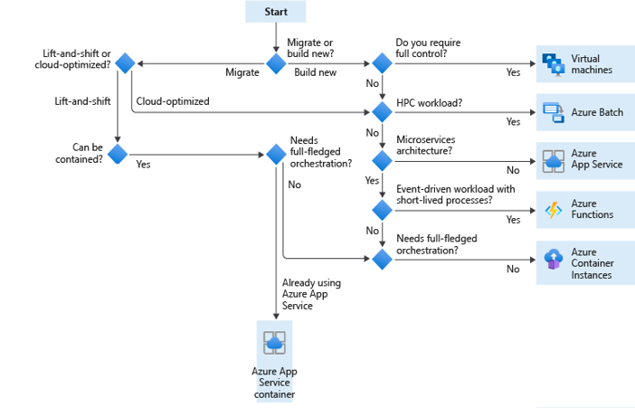
What is Azure Container Instance
Azure Container Instances offers the fastest and simplest way to run a container in Azure, without having to manage any virtual machines and without having to adopt a higher-level service.
Ensure the integrity of images throughout the lifecycle
Monitor container resource activity
Consider container groups

Slide 20

When to use Azure Container Instances
Azure Container Instances are a fast and simple way to run a container on Azure.
Pros:
Fast and Easy
Used for testing and development.
Used for short-lived processes.
Can be used for AKS overflow
Cons:
Doesn’t scale
Not designed for microservices
Notes:
Azure Container Instances - https://docs.microsoft.com/azure/container-instances/container-instances-overview
Security considerations for container instances - https://docs.microsoft.com/azure/container-instances/container-instances-image-security
Return to the first flow chart and discuss how to get to the container instances decision.

Slide 21
Azure Kubernetes Service Design

Slide 22

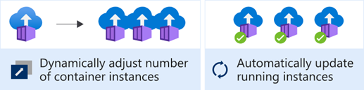
Considerations for Azure Kubernetes Services
Azure Kubernetes Service (AKS) orchestrates your containerized applications
Enterprise scalability
Automatic cluster node and pod scaling
Granular network control
Cluster node upgrades
Storage volume support
Ingress with HTTP application routing support
Private container registry support
Notes:
Introduction to Azure Kubernetes Service - https://docs.microsoft.com/learn/modules/intro-to-kubernetes/2-what-is-kubernetes
What is AKS - https://docs.microsoft.com/azure/aks/intro-kubernetes
Customer story - Mercedes-Benz R&D creates 'container-driven cars' powered by Microsoft Azure - https://customers.microsoft.com/story/784791-mercedes-benz-r-and-d-creates-container-driven-cars-powered-by-microsoft-azure
Cluster operator and developer best practices to build and manage applications on Azure Kubernetes Service (AKS) - https://docs.microsoft.com/azure/aks/best-practices

Slide 23
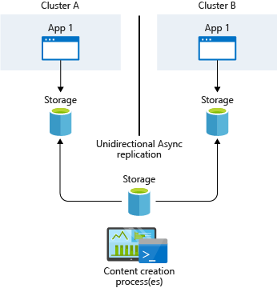
Design a highly available container solution
AKS provides high availability using multiple nodes in a virtual machine scale set.
When planning to implement AKS clusters across multiple region deployments, consider the following:
AKS region availability
Azure paired regions
Service availability
Two ways to synchronize storage.
Infrastructure-based asynchronous replication
Application-based asynchronous replication
Notes:
NOTE: Persistent volumes follow pods even if the pods are moved to a different node inside the same cluster.
https://docs.microsoft.com/azure/aks/operator-best-practices-multi-region#infrastructure-based-asynchronous-replication
Typically, you provide a common storage point where apps write their data. This data is then replicated across regions and accessed locally, as displayed in the graphic.
TIP: When you deploy multiple AKS clusters, choose regions where AKS is available. Always use paired regions.
Consider multiple region availability
When planning to implement AKS clusters across multiple region deployments, consider the following:
AKS region availability. Choose regions that are close to your users. Keep in mind that AKS is continually expanding into new regions.
Azure paired regions. For your geographic area, choose two regions paired together. Also consider that:
AKS platform updates (planned maintenance) are serialized with a delay of at least 24 hours between paired regions.
Recovery efforts for paired regions are prioritized where needed.
Service availability. Decide whether your paired regions should be hot/hot, hot/warm, or hot/cold. In other words, do you want to run both regions at the same time, with one region ready to start serving traffic? Or do you want to give one region time to get ready to serve traffic?

Slide 24
Azure Functions Design

Slide 25
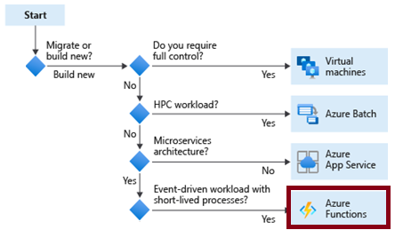
When to use Azure Functions
Azure Functions is a serverless application platform for compute-on-demand
Implement your system's logic into readily available blocks of code
Supports a microservice design
Promotes code reuse
Scales easily
Event-driven
Notes:
Azure Functions - https://docs.microsoft.com/azure/azure-functions/functions-overview
Azure Functions code samples - https://docs.microsoft.com/samples/browse/?expanded=azure&languages=csharp&products=azure-functions
Durable functions - https://docs.microsoft.com/azure/azure-functions/durable/durable-functions-overview?tabs=csharp

Slide 26
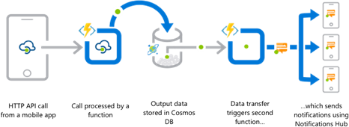
Considerations for Azure Functions
Azure Functions are best when handling specific definable actions triggered by an event.
Avoid long running functions
Know when to use durable functions
Organize functions for performance and scaling
Write defensive functions
Notes:
Best practices for reliable Azure Functions - https://docs.microsoft.com/azure/azure-functions/functions-best-practices
Relativity, an e-discovery company, is using Azure functions to identify and resolve performance issues - https://customers.microsoft.com/story/relativity-partner-professional-services-azure

Slide 27
The complete migration plan – Q&A

Slide 28
Abdul Rasheed Feroz Khan
feroz@codesizzler.in
@TechFero

